Slide 1


“URBAN MOBILITY WITH INTELLIGENCE PARKING SYSTEM”
Mini Project Presentation
Kusuma J 1AT20EC078
M B Sinchana 1AT20EC085
Sneha S R 1AT20EC141
Project guide: Dr. Prasuna VNP Associate Professor, Dept of ECE, Atria IT, Bengaluru
Department of Electronics & Communication Engineering,
Atria Institute of Technology, Bengaluru
Mini Project Presentation

Slide 2
Presentation Overview
Introduction
Literature review
Problem statement
Project overview with Block diagram
Methodology
Expected Outcomes
Obtained outcome
Applications
References

Slide 3
Introduction
To revolutionize parking management by developing an advanced system that combines automation and intelligent sensing technology.
This project seeks to address these challenges by introducing a cutting-edge solution that detects and communicates empty parking slots to drivers in real-time.
The “Automated Car Parking with Empty Slot Detection" project focuses on developing a system that utilizes advanced sensors, such as cameras or ultrasonic sensors, to detect the occupancy status of each parking slot.
This real-time sensing data is then processed by an intelligent algorithm, which accurately identifies and communicates the availability of parking spaces to drivers.

Slide 4
Literature Survey
Author | Title
Pala Z and Inanc N September 2007 IEEE | “Smart Parking Applications Using RFID Technology”
Norazwinawati Bashar Uddin, R. Yusnita, Fariza Norbaya 2012 IEEE | “Intelligent Parking space detection system based on image Processing”
M.A.R. Sarkar, A.A. Rokoni, M.O. Reza, M.F. Ismail 2012 IRJET | “Smart Parking system with image processing facility”

Slide 5
Problem Statement
The current urban mobility lacks efficient parking systems, leading to traffic congestion, wasted time, and fuel consumption. Manual processes and outdated technology hinder effective parking management, while the lack of real-time information frustrates drivers. A smart parking system is needed to optimize urban mobility, enhance user experience, and address issues of limited parking space, inconvenience, and security concerns.

Slide 6
Block Diagram
LCD Display
IR Sensor 1 for Entry Gate
IR Sensor 2 for Entry Gate
IR Sensor 3
for Slot 1
Arduino UNO
mg90 servo Motor
IR Sensor 4
for Slot 2
IR Sensor 5
for Slot 3
IR Sensor 6
for Slot 4
Power Supply

Slide 7
Methodology
Embedded C programming plays role in performing specific function.
Consists of deployed IoT(Internet of Things) which delivers real-time output and monitors the flow of the parking of vehicles.
Displays data about free and occupied parking slots.
The device includes IR sensors located in each parking place.
Output: Once the slots are full the LCD displays slots full and gate do not open.

Slide 8
Expected outcomes of the project
Optimize parking space utilization, reduce search time for parking spots, and minimize congestion.
Real-time information on parking availability, easy spot location.
Guiding drivers to available parking spaces reduces the number of vehicles circling for parking, leading to reduced congestion.
Promoting efficient parking management and reduced congestion aligns with sustainable urban development goals.

Slide 9
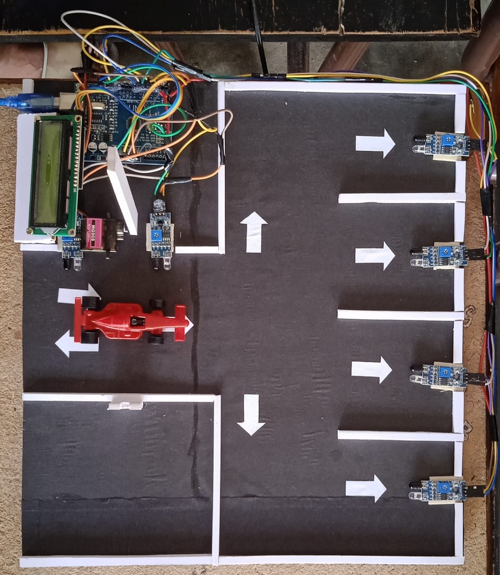
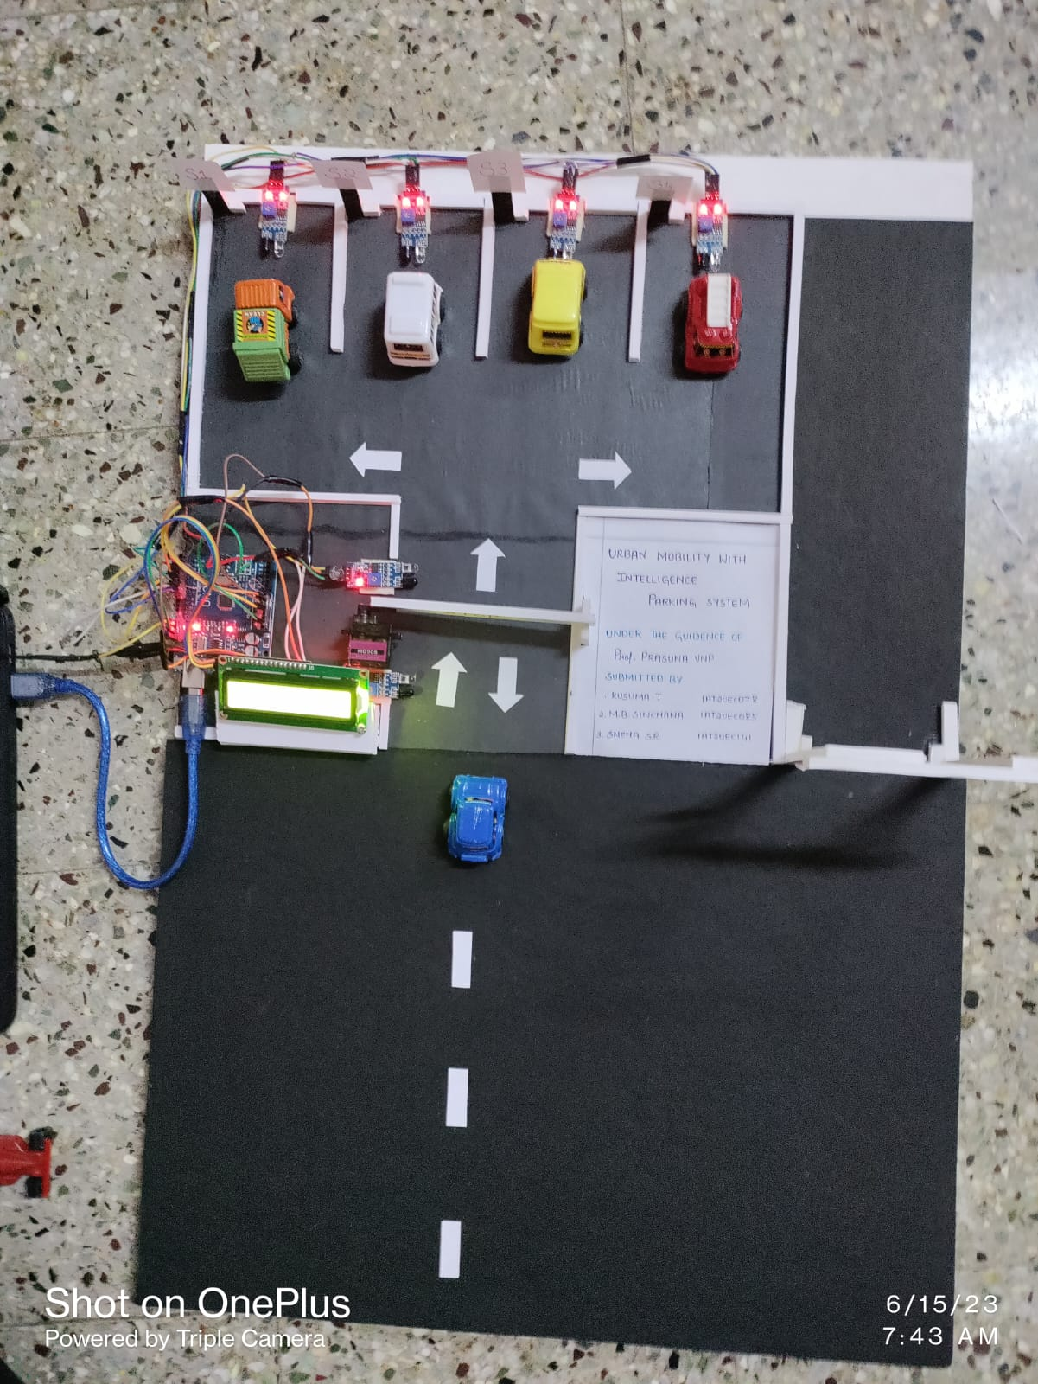
Obtained output
Before After

Slide 10
Applications
Real-time parking availability
Parking guidance and navigation
Payment automation
Traffic flow management
Sustainability and environmental benefits
Enforcement and security

Slide 11
References
M. Ataur Rehman, M.M. Rashid, A. Musa, A. Farhana and N. Farhana, “Automatic parking management and parking fee collection based On Number Plate Recognition”, International Journal of Machine Learning and Computing, vol. 2, no. 2, pp. 93-98, 2012.
Norazwinawati Bashar Uddin, R. Yusnita, Fariza Norbaya ,“Intelligent Parking space detection system based on image Processing”, International Journal of Innovation, Management and Technology, vol. 3, no. 3, pp. 232-253, 2012.
Patrick Sebastian, Hamada R.H. Al-Absi, Justin Dinesh Daniel Devraj and Yap Vooi Voon, “Vision based automated parking System”, 10th International conference on Information Science, Signal Processing and their Applications (ISSPA 2010), no. 1, pp. 757-760, 2010.
M.A.R. Sarkar, A.A. Rokoni, M.O. Reza, M.F. Ismail, “Smart Parking system with image processing facility”, I.J. Intelligent Systems and Applications, 2012, vol. 3, pp. 41-47.

Slide 12
Video link:
https://youtu.be/H6XbeBqHjMY

Slide 13
Thank you

